Slide 1
Twitter Streaming Data Analysis
- Dhwani Thobhani

Slide 2
Data Pipeline Components:
Twitter Streaming API
Cloud Pub/Sub
Cloud Storage Bucket
Cloud Composer
BigQuery
BI Analyst
Data Studio

Slide 3
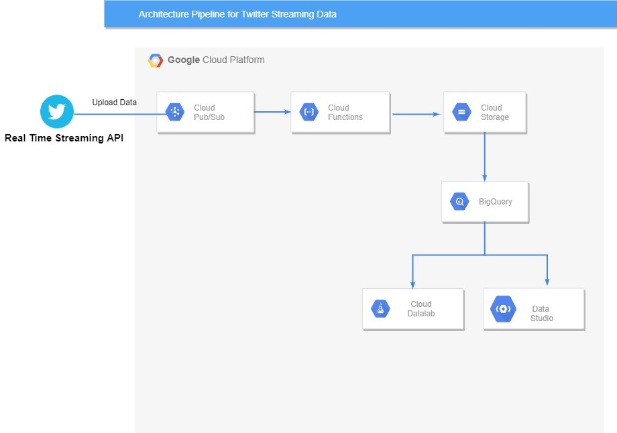
Data Pipeline Architecture

Slide 4
Data Pipeline:
The pipeline here uses Google Cloud Platform to process data efficiently and make analysis easier.
The flow of the project:
StreamToPubSub.py:
  This file contains all the essential code to fetch the data Twitter Real time data Streaming API
  Pub/Sub Topic stores the published data from API
PubSubToGCS.py:
  This file is uploaded while creating Cloud Function named Fetch Data.
  It extracts contents from the fetched data later creates data frame using it .
  This sequence of data frames are stored in the GCS bucket created on platform.
BigQuery:
  The dataset is created using GCP console and added table which stores the data.
  We can query them according to our need and perform analysis.
Data Studio:
  Creating Interactive Visualizations and Dashboards according to required data

Slide 5
Business Relevance of Project:
. Twitter remains most popular platform for research, and we can perform analysis in variety of ways such as content analysis, social network analysis, semantic analysis, Time series analysis etc.
Considering business relevance, we can measure the impact of the data being consumed by the users and strategically design how the engagement can be increased.

Slide 6
Thank you!

